Slide 1



Powering eCommerce Success Team 8
Rana Rasheed Sherif Ahmed
Abdelrahman Sorour Omar Mamdouh
Youssef Fawzy Elham Mohamed
Ahmed Ayman Abdelaziz Mohamed

Slide 2



Objective
Deliver a comprehensive e-commerce analytics solution by developing advanced SQL queries and Python scripts for data analysis and predictive modeling, integrating AI techniques to address business challenges, creating interactive Power BI dashboards, and deploying the database on Azure using Azure Data Factory—all within a $100 budget.
Key
Deliverables
SQL Queries: Develop both basic and advanced queries to support comprehensive analytics. Python Scripts: Perform data cleaning and predictive modeling using libraries such as pandas, scikit-learn, and optionally Mito or yolopandas. Power BI Dashboards: Build interactive dashboards to visualize sales, customer, and product analytics for informed decision-making. Azure Deployment: Host the e-commerce database on Azure SQL Database and migrate data efficiently using Azure Data Factory, while maintaining a $100 budget. AI Integration: Apply AI techniques to shape business strategies, address key challenges, and deliver actionable solutions. Documentation: Prepare clear PDF/PowerPoint documentation summarizing the setup, queries, dashboards, AI-driven insights, and business outcomes
PROJECT OVERVIEW
Our project focuses on analyzing a comprehensive e-commerce database that simulates real-world online retail operations. The database includes detailed and interconnected tables that cover essential components such as:
Product and inventory management *Customer profiling and interactions
Order processing, shipping, and returns *Payments and discount management
Customer feedback and behavior tracking

Slide 3
Sales Performance & Product Trends
- Total revenue shows overall business performance.
- Top-selling products reveal what's driving that revenue.
- Average product ratings reflect customer satisfaction with what they buy.
- Declining Customer Acquisition
- Drop in Monthly Sales
- Low Customer Satisfaction.
- Limited Customer Base
- Track revenue + reviews together for a full product picture.
- Invest more in what’s working; revise or phase out poorly rated items.
- Sync marketing campaigns with bestsellers and customer favorites.

Slide 4
Customer Behavior & Loyalty
- Identify repeat buyers and top customers.
- Measure 30-day retention to gauge loyalty.
- Find those who purchase entire categories—your super fans.
- Losing track of high-value customers.
- Poor retention = wasted acquisition cost.
- Ignoring niche shoppers who love a specific product line.
- Recognize and reward loyal buyers with tailored programs.
- Use retention data to refine onboarding and follow-up.
- Create exclusive category-based offers for high-engagement users.

Slide 5
Inventory Management
- Low stock alerts prevent revenue loss.
- Inventory turnover trend shows how fast things sell.
- Stock depletion from high-demand can be forecasted and managed.
- Out-of-stock = missed sales.
- Overstock = cash stuck in inventory.
- Hard to track product movement without automation.
- Monitor turnover and low stock in one dashboard.
- Use 30-day moving averages to guide purchasing.
- Automate alerts to avoid surprises.

Slide 6
Smart Promotions & Discount Strategy
- See how many orders use discounts.
- Understand when and where discounts hurt margins.
- Pair discount data with product popularity and retention.
- Blind discounting may erode profits.
- Customers expect discounts and delay buying at full price.
- No clarity on which offers work.
- Analyze discount usage + product demand together.
- Refine pricing strategies to offer value without dependency.
- Test promotions on low-performing items only.

Slide 7
Fulfillment & Customer Experience
- Track delivery durations to assess logistics.
- Late shipping affects satisfaction and reviews.
- Delivery time also impacts retention and returns.
- Unpredictable delivery = unhappy customers.
- Hard to benchmark shipping providers.
- No link between logistics and churn.
- Measure shipping performance consistently.
- Address "bad shipping" with faster logistics or clear comms.
- Prioritize delivery improvements for high-value customers.

Slide 8
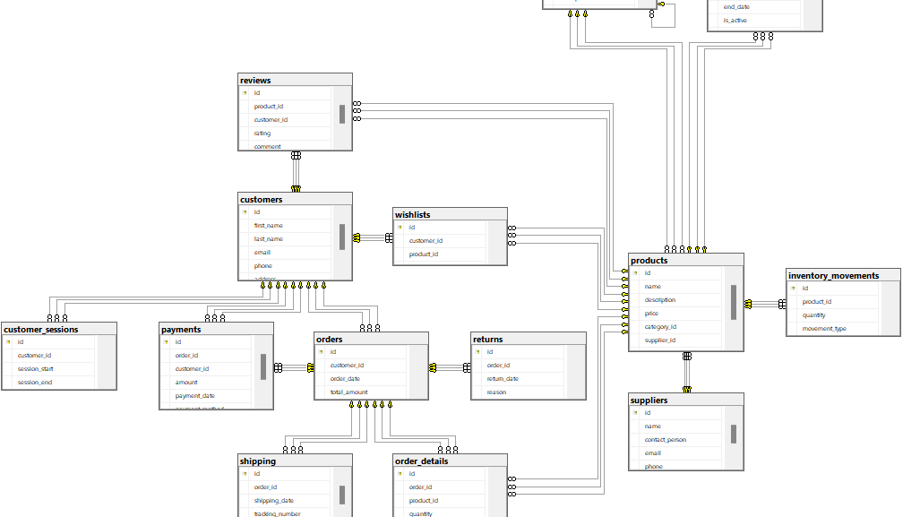
SQL SERVER SCHEMA

Slide 9
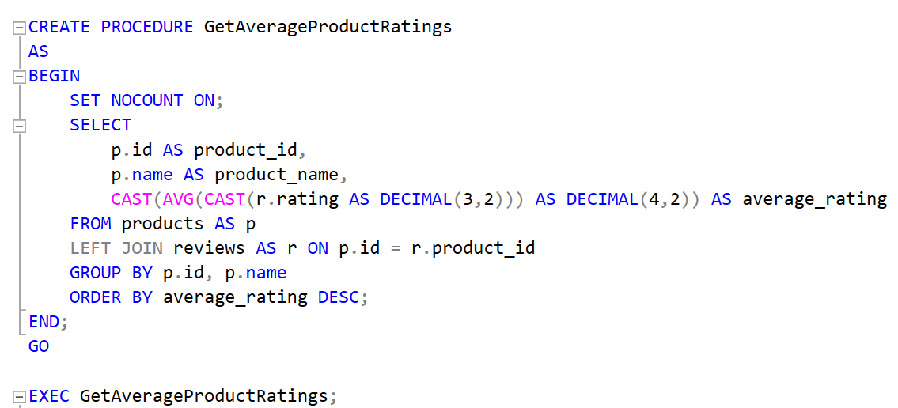
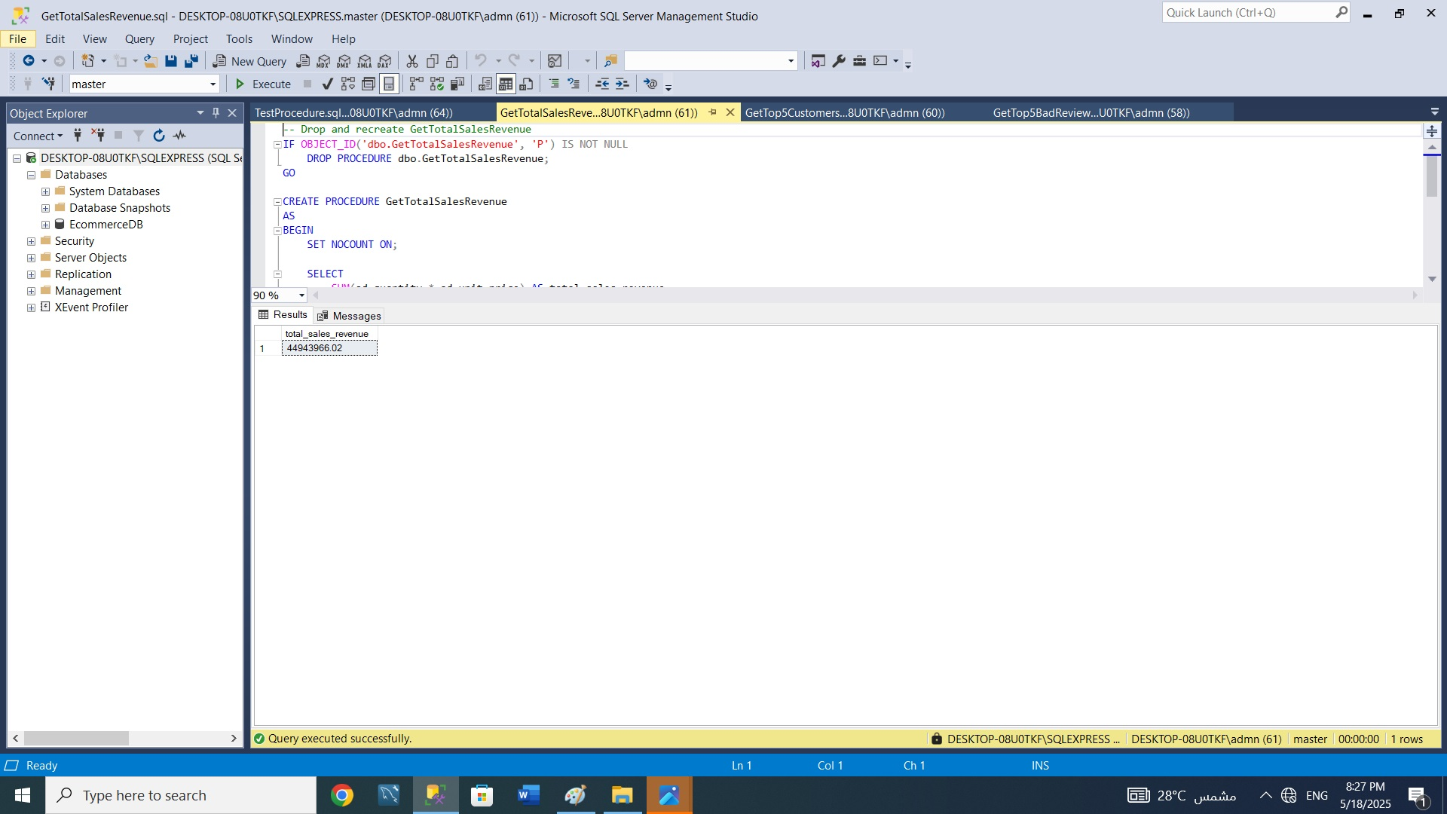
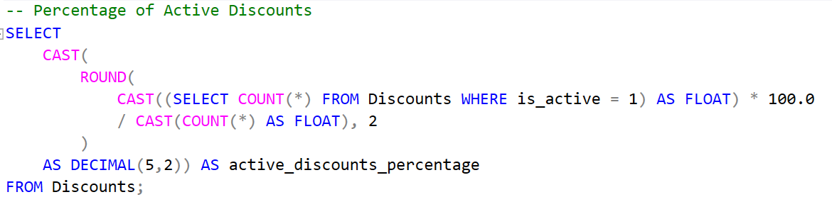
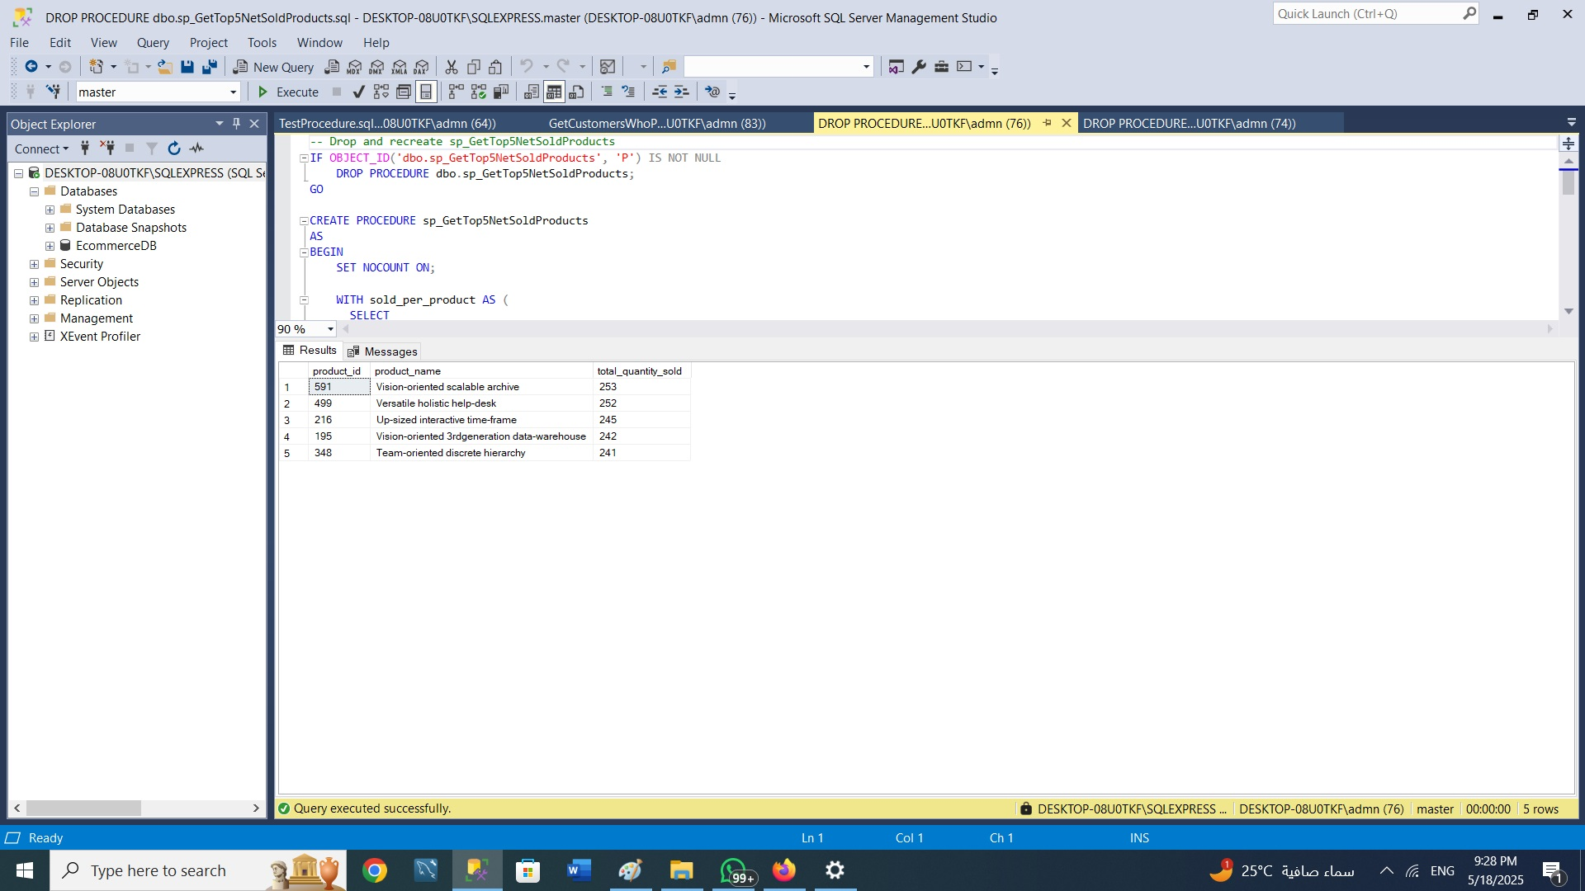
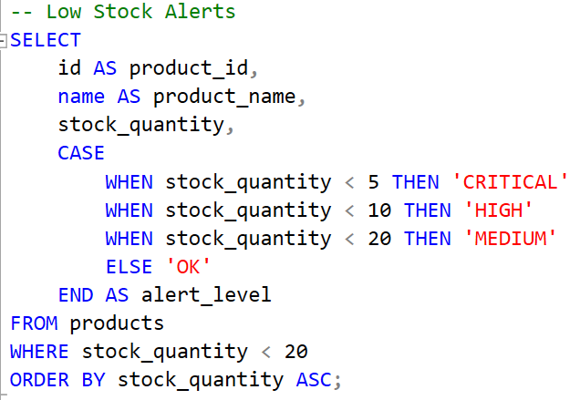
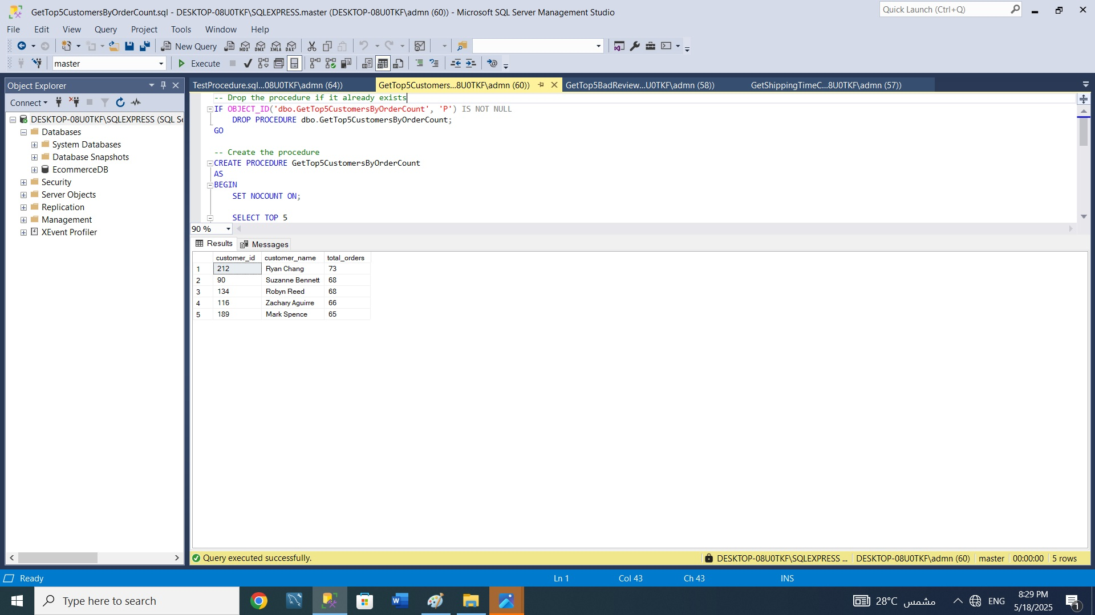
SQL Queries
Average rating for each product.
Total Sales Revenue
Percentage of active discounts
Alert level for products with stock quantities below 20 units
Top 5 best-selling products
customers with the highest number of orders

Slide 10
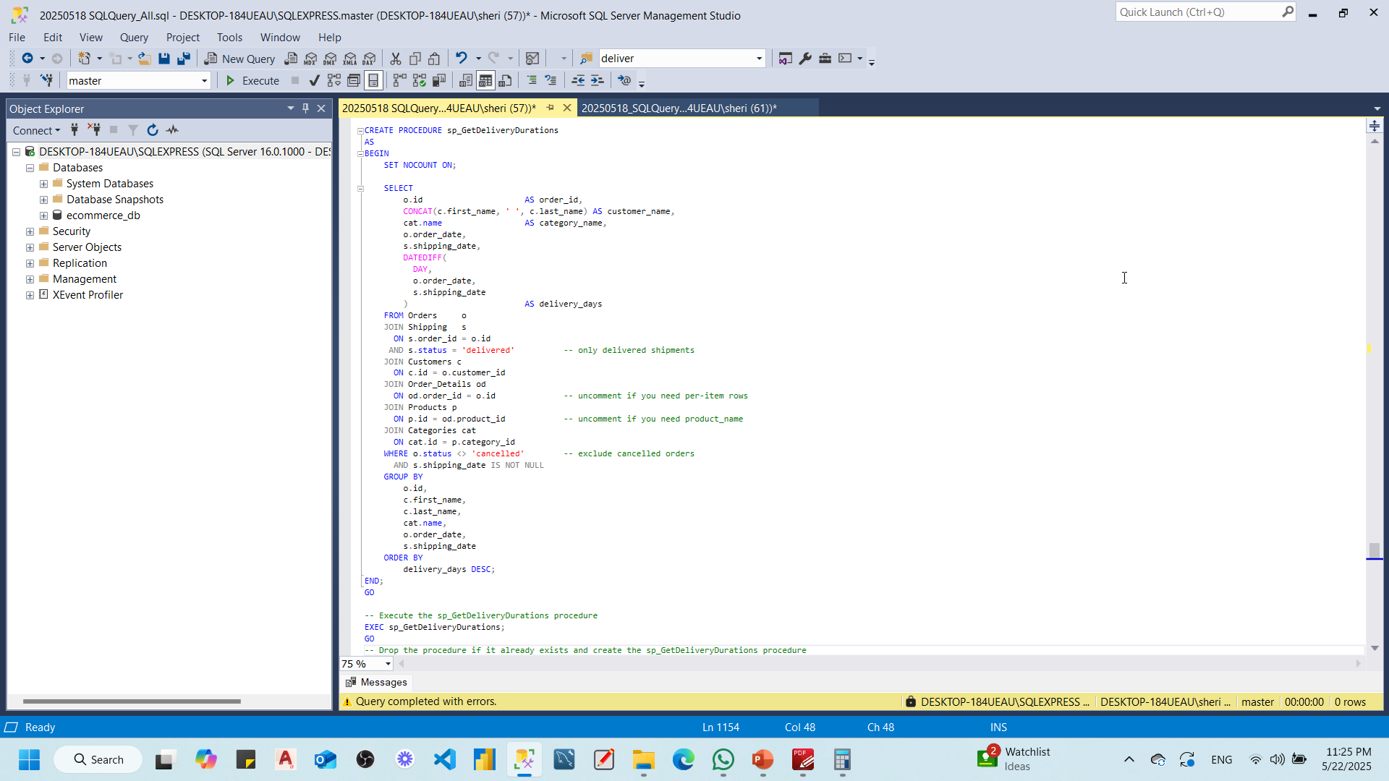
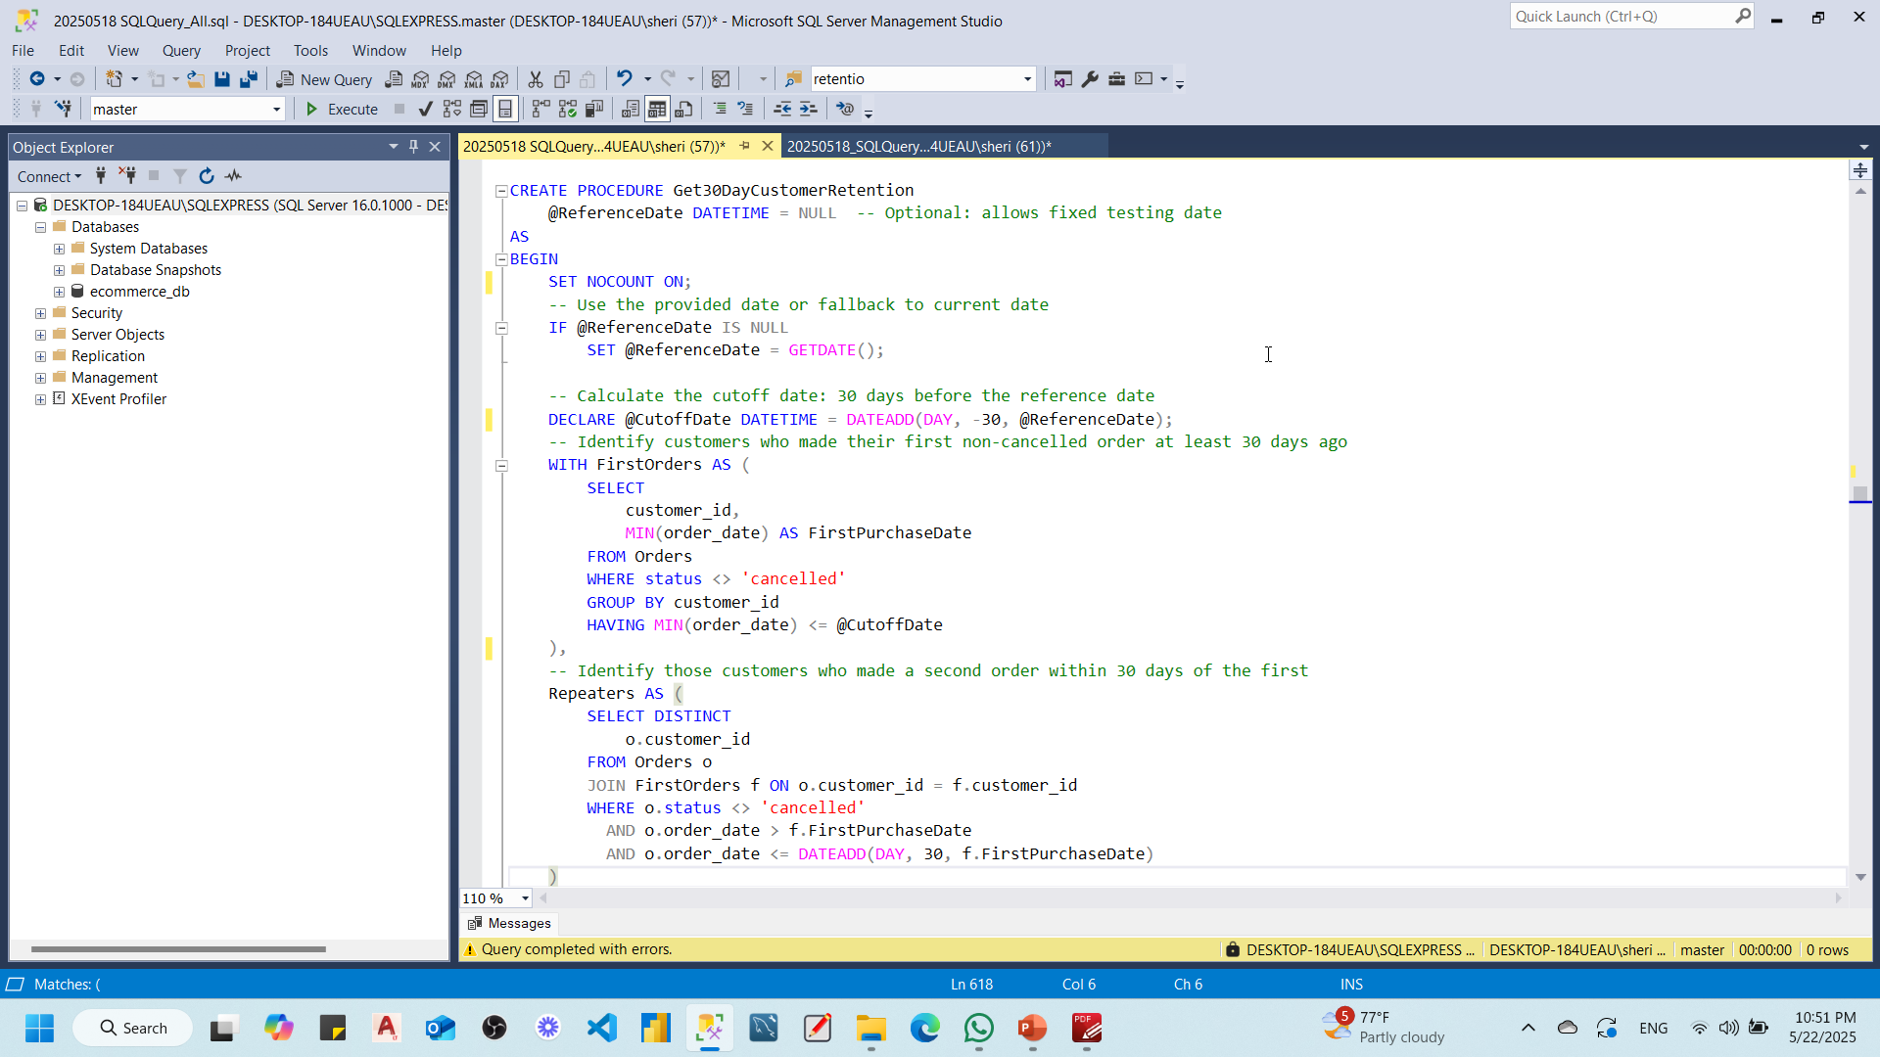
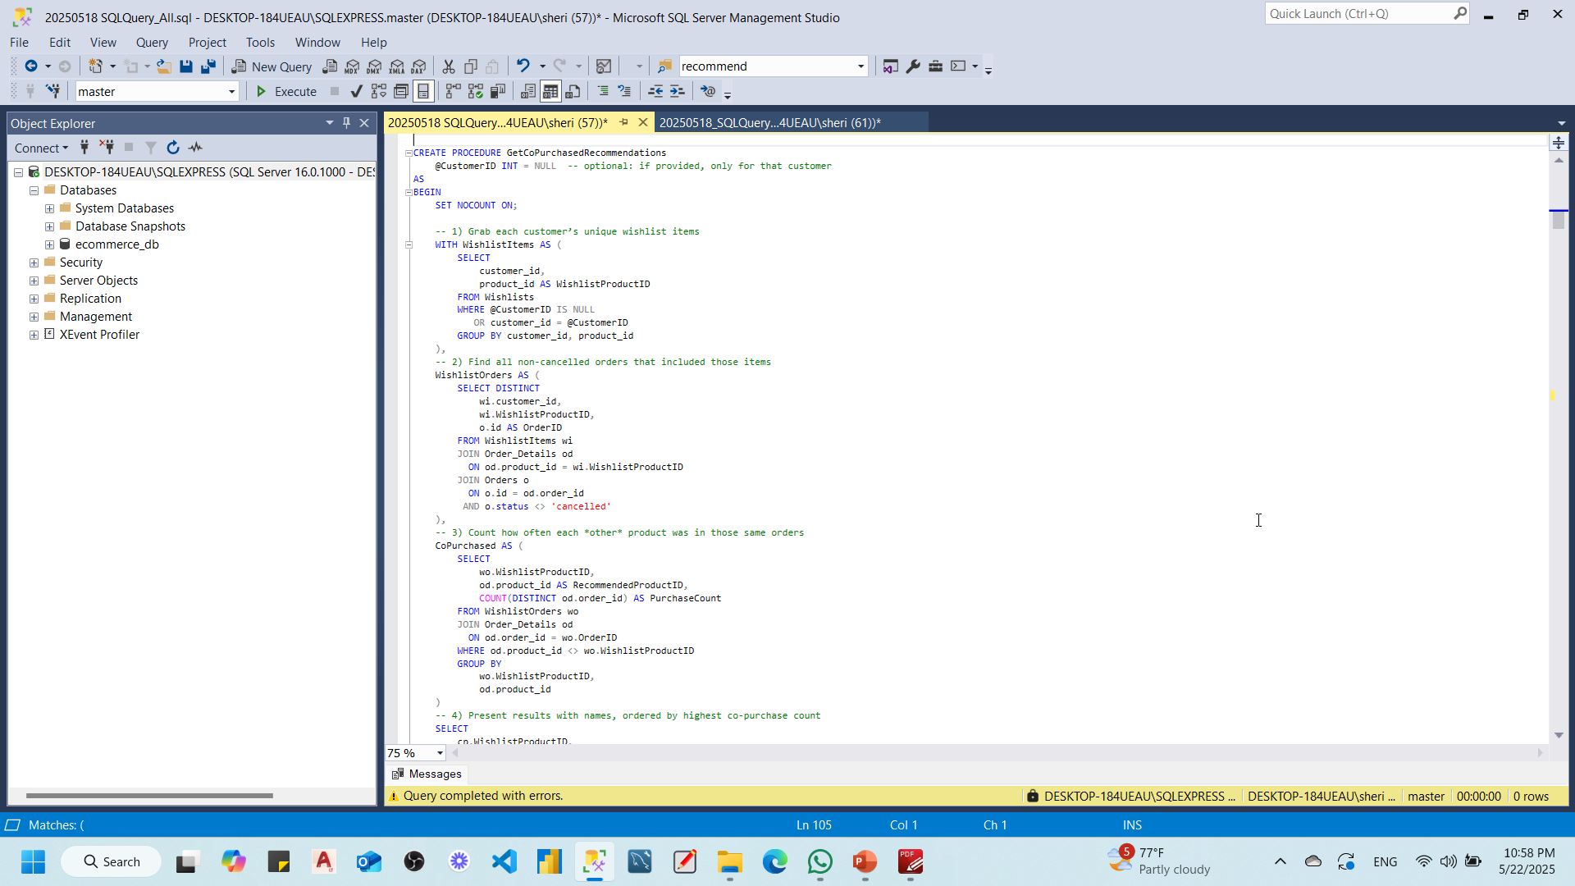
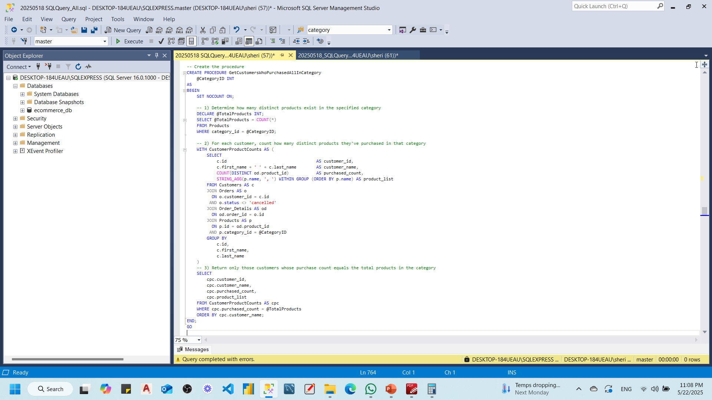
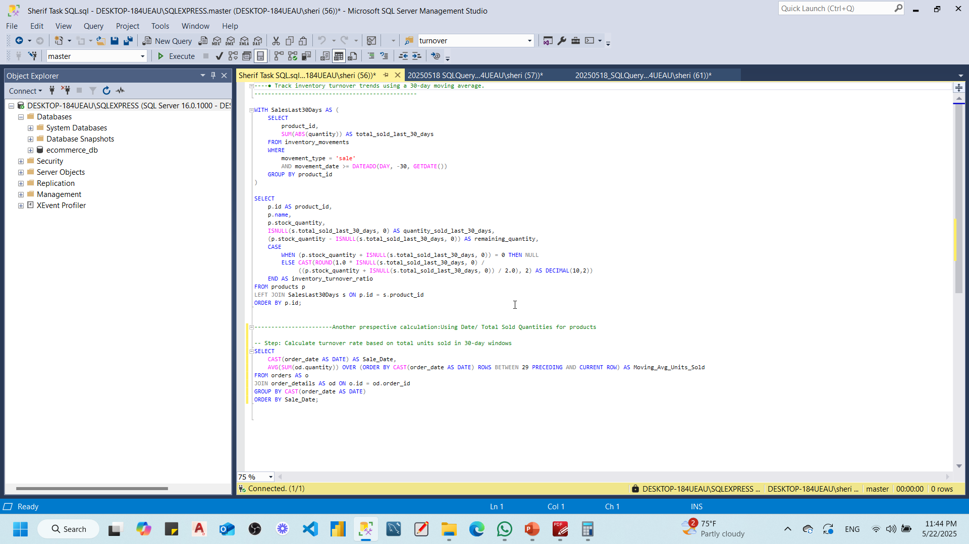
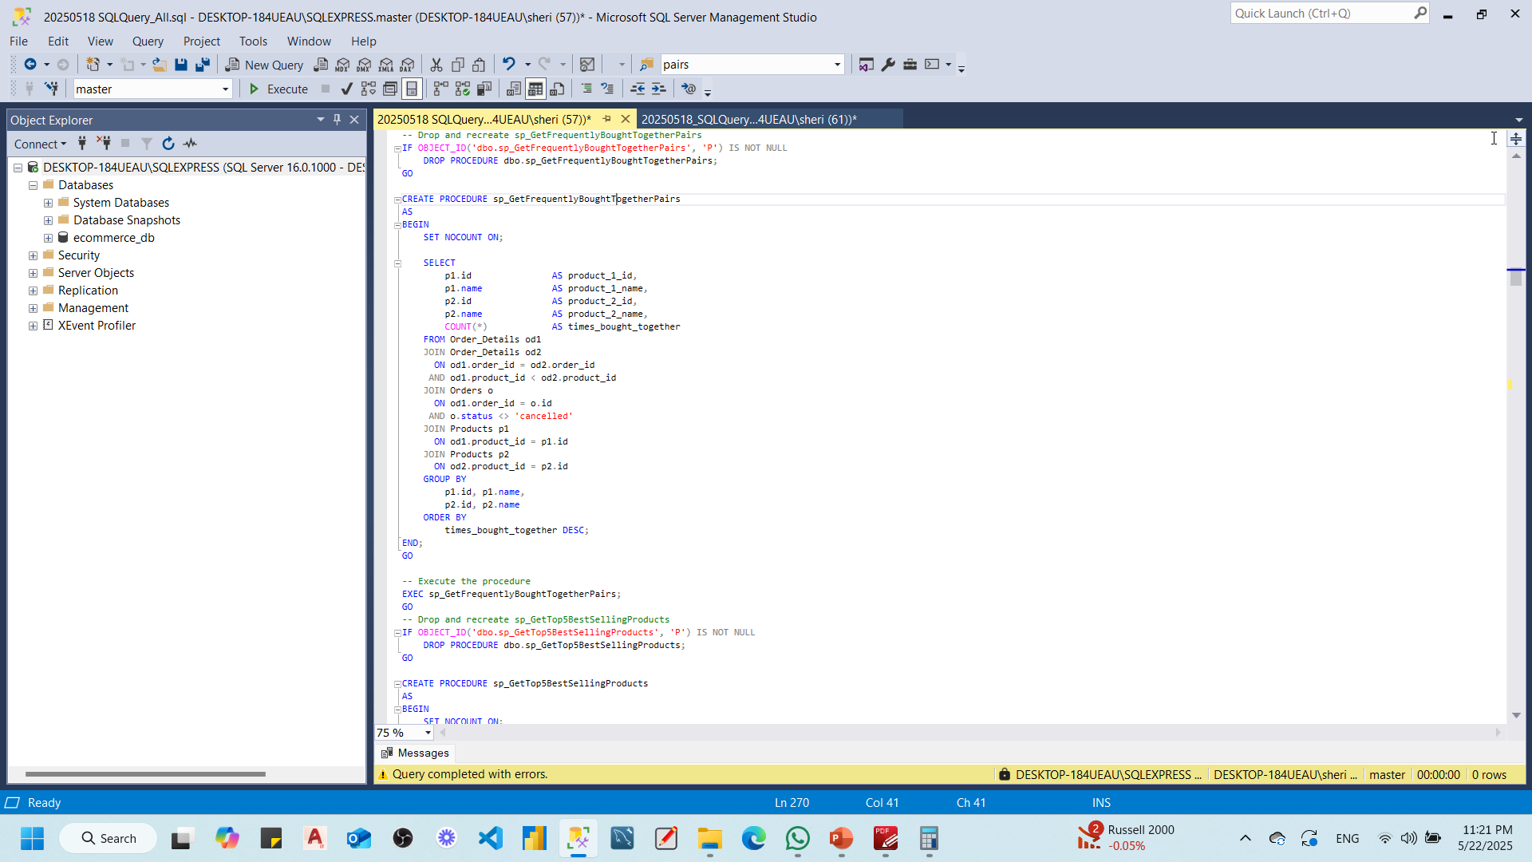
SQL Queries
Time taken to deliver orders in days
30-day customer retention rate after their ﬁrst purchase
Recommend products frequently bought together with Wishlist Items
pairs of products commonly bought together
Customers who have purchased every product in a speciﬁc category.
30-day moving average

Slide 11
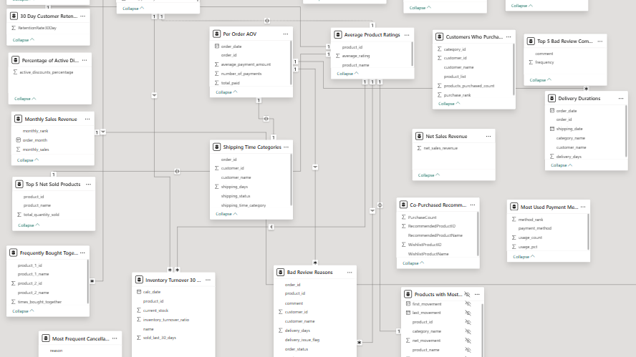
Import SQL Queries into PowerBi
Notes:
Import queries to be specific , get points from ai

Slide 12
Introduction
Python
Overview
This project analyzes sales trends, customer behavior, and product recommendations for our e-commerce platform, aiming to enhance overall business performance.
Objectives
Sales Forecasting : Predict future sales based on historical data.
Customer Segmentation : Identify distinct customer groups for targeted marketing.
Product Recommendation : Suggest products to improve sales and enhance customer experience.

Slide 13
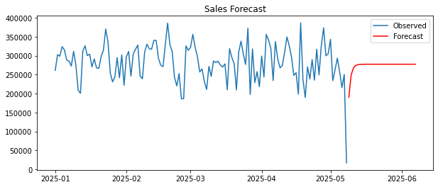
ETL Process
Python
Data Source :
E-Commerce Azure database.
Tools Used :
Python with Pandas for data manipulation.
Challenges :
Ensuring data quality and consistency.
Methodology :
Utilized time series analysis with Prophet.
Insights :
Sales are projected to stabilize around 270,000 after a sharp decline, indicating a potential recovery from recent volatility.
Tools :
Pandas for data manipulation & Prophet for time series forecasting.
Sales Forecasting

Slide 14
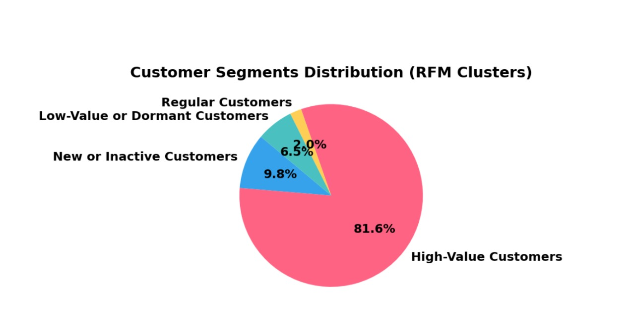
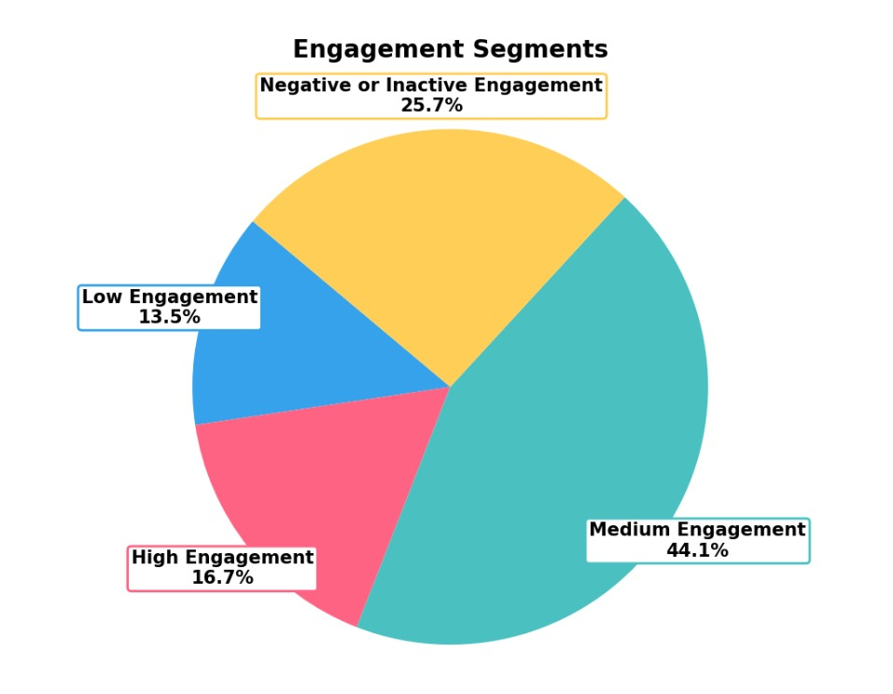
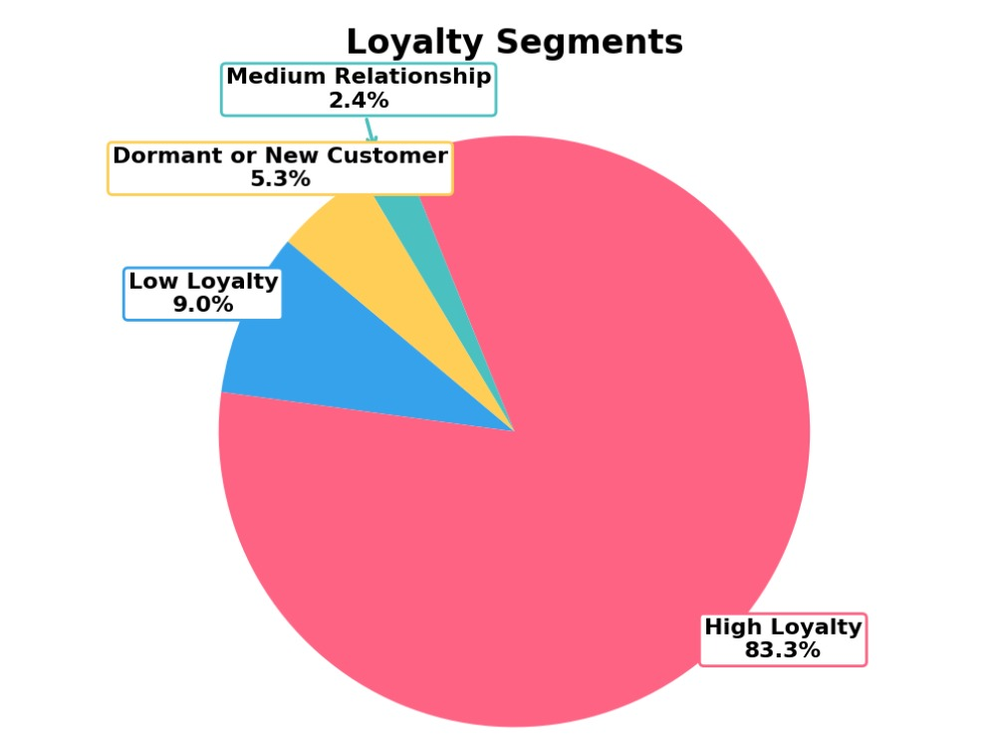
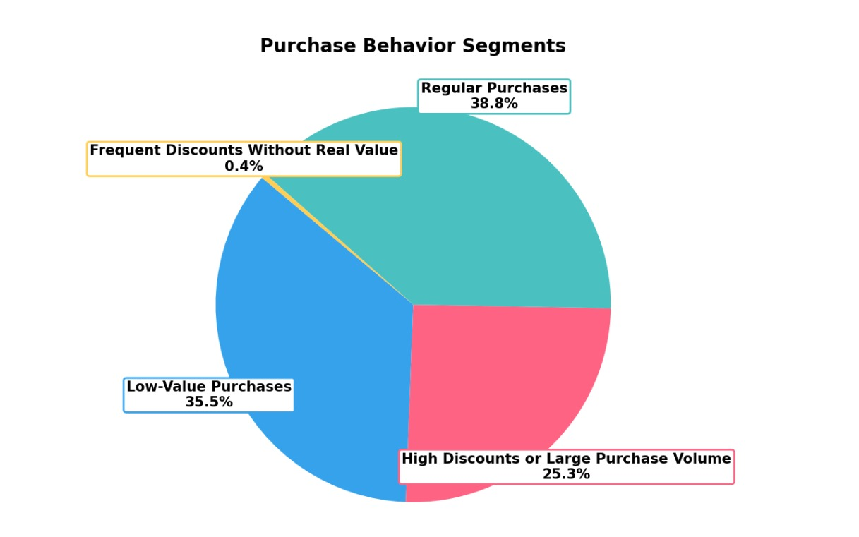
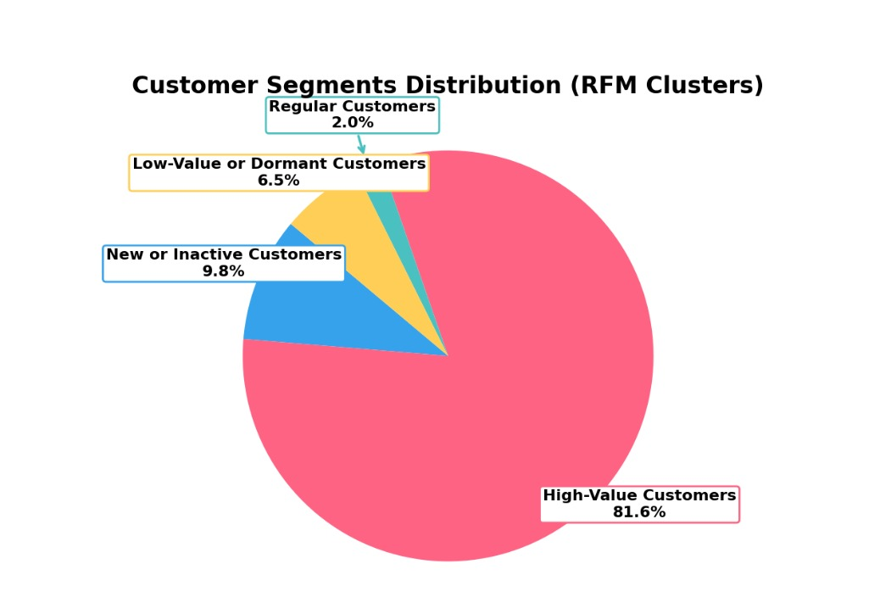
Customer Segmentation
Python
Approach:
Implement K-means clustering to group customers based on purchasing behavior and demographics.
Data Features :
Purchase frequency, average order value and geographic location.
Insights :
Each cluster reveals a unique customer profile, helping us tailor marketing strategies and improve customer retention.
Visualization

Slide 15
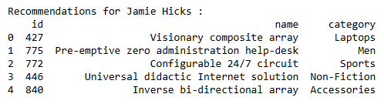
Product Recommendation
Python
System Type :
Hybrid filtering based on customer preferences & behaviors and products information.
Algorithms Used :
Collaborative filtering and content-based filtering techniques.
Visualization : (sample recommendation list)

Slide 16

PowerBi
eCommerce Analytics & Advanced Insights
Team 8

Slide 17

PowerBi (Overview)
Notes:
This ecommerce dashboard Overview reveals several key points:
* The business has generated $44.94M in total revenue from 250 customers and 8,000 orders, with an average order value (AOV) of $4.41K.
* The repeat purchase rate is very high at 98%, and the 30-day customer retention rate is also strong at 92%.
* However, the average customer rating is only 3.0 out of 5, with just 60% positive feedback.
* Customer acquisition is declining sharply, dropping from 80 in January 2025 to just 10 in May 2025.
* Sales per month are steady from January to April (around $8M+), but there is a significant drop in May (to $1.9M).
* Payment methods are evenly split among PayPal, bank transfer, and credit card (each about 33%).
Challenges
Declining Customer Acquisition: The number of new customers acquired each month is falling rapidly.
Drop in Monthly Sales: May 2025 shows a dramatic decrease in sales compared to previous months.
Low Customer Satisfaction: The average rating is mediocre (3.0/5), which could impact future growth and reputation.
Limited Customer Base: Despite high revenue, the total customer count is low (250), indicating high-value but few customers, which is risky for long-term stability.
Action Plan
To address these challenges, consider the following steps:
1. Boost Customer Acquisition
Invest in targeted marketing campaigns (social media, search ads, influencer partnerships) to attract new customers.
Offer referral incentives to existing customers to bring in new buyers.
Analyze acquisition channels to identify and double down on the most effective ones.
2. Address Sales Drop
Investigate the cause of the sales decline in May (e.g., seasonality, stock issues, marketing lapses).
Launch limited-time promotions or discounts to stimulate demand.
Ensure inventory and logistics are not causing bottlenecks.
3. Improve Customer Satisfaction
Collect and analyze customer feedback to identify pain points.
Enhance customer support and after-sales service.
Implement quality control measures to address product or service issues.
Consider loyalty programs or personalized offers to increase satisfaction.
4. Expand Customer Base
Diversify product offerings to appeal to a broader audience.
Explore new markets or demographics.
Collaborate with complementary brands for cross-promotions.
5. Monitor and Optimize
Set up regular reviews of key metrics (acquisition, retention, satisfaction, sales).
Use A/B testing for website and marketing optimizations.
Continuously gather and act on customer insights.

Slide 18
PowerBi (Customers)

Slide 19
PowerBi (Orders)

Slide 20
PowerBi (Categories)

Slide 21
Azure Cloud Migration
eCommerce Analytics & Advanced Insights
Team 8

Slide 22

Overview of Responsibilities
Role Led Azure Cloud
Architecture and Deployment
Scope
Azure SQL deployment & security
Data Migration
Cost Optimization
Integration with Power BI & ML Pipeline

Slide 23





Project Scope
Cost Optimization
Azure Deployment & Security
Monitoring Cost.
Applied Cost Optimization.
TLS Encryption
Whitelisted Public IP’s
Transparent Data Encryption
Integration With Power BI & Pipelines
Data Migration
Connecting Power BI.
Data Factories Pipelines.
Using Microsoft SQL Management Server.
Connecting To Server.
Adding SQL Procedures.

Slide 24
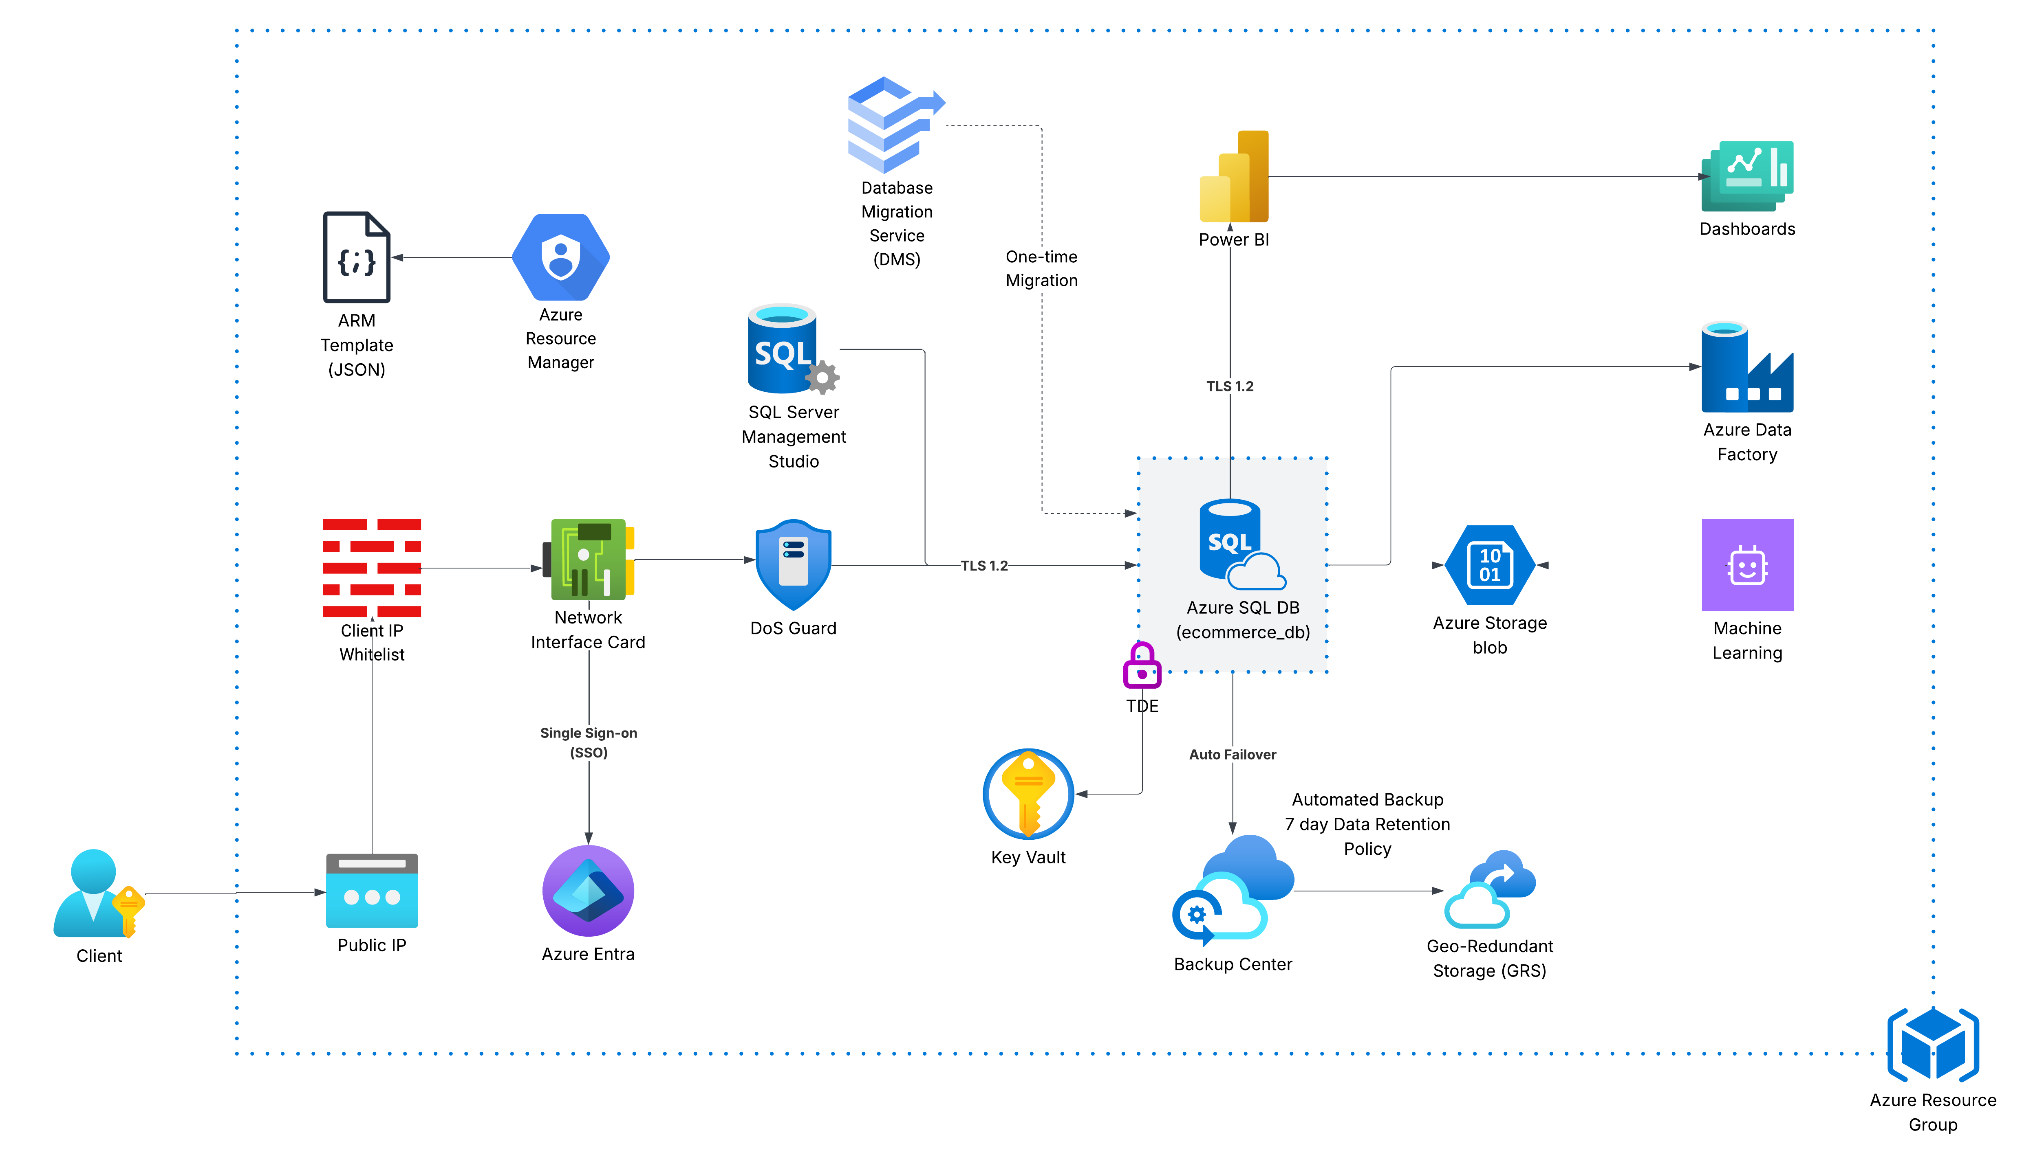
Architecture Diagram

Slide 25
Deployment Challenges
A
Accelerated Learning
Steep learning curve required in a short time-period
B
Budget Constraints
Limited resources due to trial account budget of $100
C
Cost Optimization
DDosGuard, GDS late deployment and Database auto-pause
D
Data Integrity
Dataset integrity and lack of data volume required for ML

Slide 26
Action Plan Based on Business Insights
1. Maximize CLTV
• Target high-value customers with retention campaigns
• Offer loyalty rewards or exclusive offers
2. Minimize Revenue Leakage
• Analyze return reasons and identify high-return products
• Refine discounting strategies to protect profit margins
3. Leverage Wishlist Behavior
• Send targeted promotions for wishlisted products
• Create urgency with limited-time offers
4. Optimize Product Portfolio
• Promote high-performing products
• Review or remove underperforming SKUs
5. Improve Session Conversion
• Investigate drop-offs in user sessions
• A/B test product pages, CTAs, and navigation flow

Slide 27
Thanks
Any Questions ?

Slide 28
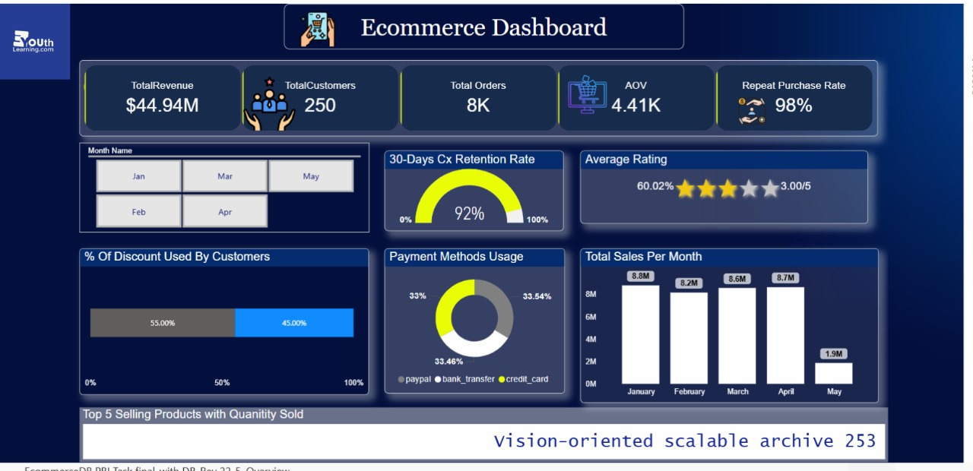
PowerBi (Overview)
Notes:
Slide Brief: Problems & Solutions for the Business
This dashboard highlights both strengths and key challenges in our e-commerce performance:
Problems Identified:
Sharp Drop in Sales: While sales were strong from January to April (over $8M each month), there’s a significant decline in May, dropping to just $1.9M. This signals a potential issue with demand, seasonality, or operational disruptions.
Low Customer Ratings: The average customer rating is only 3 out of 5, with just 60% positive feedback. This suggests customer satisfaction issues that could impact retention and reputation.
Limited Customer Base: Despite high revenue, we have only 250 customers, indicating a reliance on a small group of high-value buyers, which is risky for long-term growth.
Business Strengths:
High Retention and Repeat Purchase Rates: With a 92% 30-day retention rate and 98% repeat purchase rate, our existing customers are highly loyal.
Balanced Payment Methods: Payment usage is evenly distributed, reducing dependency on a single payment channel.
Solutions to Address Challenges:
Boost Customer Acquisition: Invest in targeted marketing and referral programs to attract new customers and diversify our customer base.
Enhance Customer Experience: Gather and act on customer feedback to improve products and services, aiming to raise our average rating and satisfaction.
Investigate Sales Drop: Analyze the reasons behind the May sales decline—such as inventory issues, marketing lapses, or external factors—and implement corrective actions like promotions or new product launches.
Summary: By focusing on acquiring new customers, improving satisfaction, and addressing the sales drop, we can build on our strengths and drive sustainable business growth.
Let me know if you want this tailored for a specific audience or need talking points for each problem and solution!

Slide 29
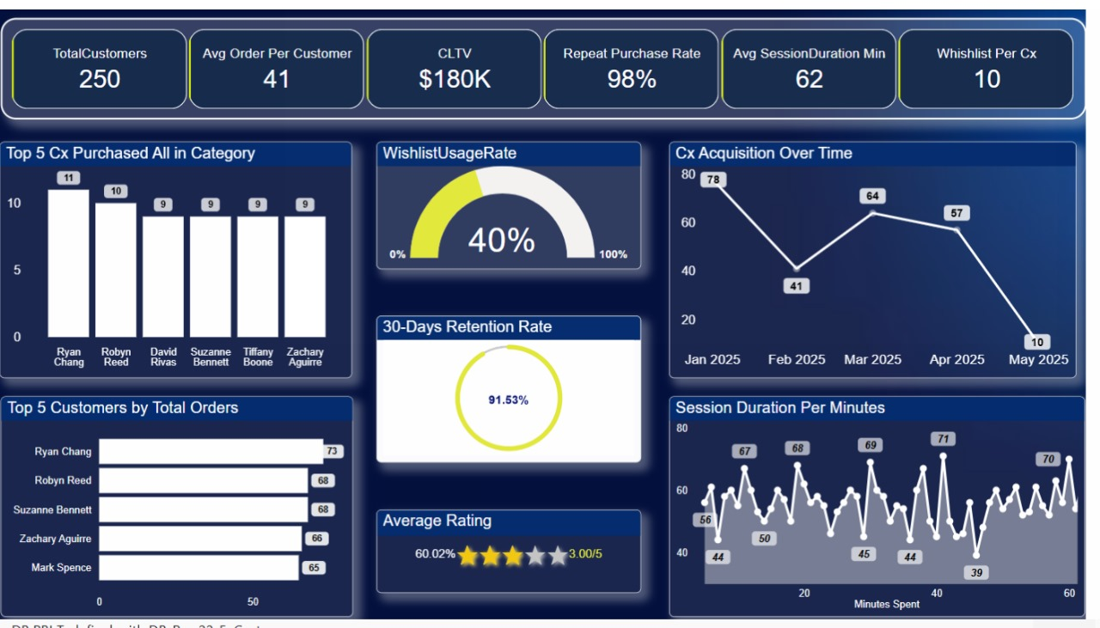
PowerBi (Customers)
Notes:
Here’s a brief you can use to present this slide, focusing on the main business problems and solutions:
Slide Brief: Problems & Solutions for the Business
Key Problems Identified:
High Order Cancellation Rate: Out of 8,190 total orders, 2,000 were cancelled—almost 25%. This indicates issues in the order process, product availability, or customer satisfaction.
Low Return Rate but High Rejection: The return rate is low (0.62%), but among returned orders, 30% are rejected and 27% are still pending. This suggests inefficiencies in the returns process and possible dissatisfaction with how returns are handled.
Significant Drop in Sales: Monthly sales remain steady at around $8M from January to April, but drop sharply to $1.5M in May. This sudden decline could be due to seasonality, supply chain issues, or customer churn.
High Discount Dependency: 45% of orders involve discounts, which may be eroding profit margins and creating dependency on promotions.
Return Reasons: The most common reasons for returns are “Not as described,” “Defective,” and “Wrong size,” indicating product quality and description issues.
Business Strengths:
Consistent Product Demand: The top products have steady sales, and 11K units were sold in the last 30 days.
Clear Data on Return Reasons: The dashboard provides detailed insights into why customers return products, enabling targeted improvements.
Solutions to Address Challenges:
Reduce Order Cancellations: Improve inventory management, streamline the order process, and enhance communication with customers to reduce cancellations.
Optimize Returns Process: Review and refine the returns approval process to reduce pending and rejected returns, and improve customer satisfaction.
Address Sales Decline: Investigate the root causes of the May sales drop and implement corrective actions such as targeted marketing, new product launches, or operational improvements.
Enhance Product Quality and Descriptions: Use return reason data to improve product descriptions and quality control, reducing returns due to “Not as described” or “Defective” items.
Reevaluate Discount Strategy: Analyze the impact of discounts on profitability and consider loyalty programs or value-added services as alternatives to heavy discounting.
Summary: By focusing on reducing cancellations and returns, improving product quality, and addressing the sales decline, the business can enhance customer satisfaction, stabilize revenue, and improve profitability.
Let me know if you’d like more detailed talking points or a version tailored for a specific audience!

Slide 30
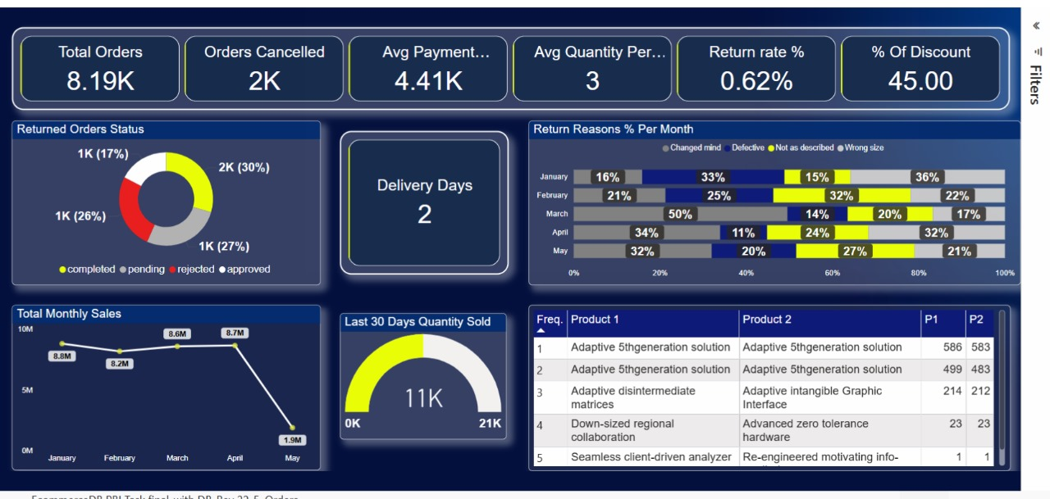
PowerBi (Orders)
Notes:
Here’s a brief you can use to present this slide, focusing on the main business problems and solutions:
Slide Brief: Problems & Solutions for the Business
Key Problems Identified:
Declining Customer Acquisition: The number of new customers acquired each month has dropped sharply, from 78 in January to just 10 in May 2025. This trend threatens future growth and market share.
Low Average Customer Rating: The average customer rating is only 3 out of 5, with just 60% positive feedback, indicating room for improvement in customer satisfaction and experience.
Limited Customer Base: The business has only 250 total customers, which is relatively low and increases risk due to over-reliance on a small group of buyers.
Wishlist Engagement: Only 40% wishlist usage rate and an average of 10 wishlists per customer suggest moderate engagement with this feature, which could be improved to drive more sales.
Business Strengths:
High Repeat Purchase and Retention Rates: With a 98% repeat purchase rate and a 91.5% 30-day retention rate, the business enjoys strong loyalty from its existing customers.
High Customer Lifetime Value (CLTV): The CLTV is $180K, indicating that each customer brings significant value over time.
Active Top Customers: The top 5 customers are highly engaged, making frequent purchases and orders.
Solutions to Address Challenges:
Revitalize Customer Acquisition: Launch targeted marketing campaigns, referral programs, and partnerships to attract new customers and reverse the downward trend.
Enhance Customer Experience: Gather and act on customer feedback to improve products, services, and support, aiming to boost the average rating and satisfaction.
Expand Customer Base: Broaden the product range and explore new market segments to attract a wider audience and reduce dependency on a small customer pool.
Increase Wishlist Engagement: Promote the wishlist feature through personalized recommendations and incentives, encouraging customers to use it more and convert wishlists into purchases.
Summary: By focusing on acquiring new customers, improving satisfaction, and increasing engagement, the business can build on its strong retention and loyalty, ensuring sustainable growth and long-term success.
Let me know if you’d like this tailored further or need specific talking points for your presentation!

Slide 31
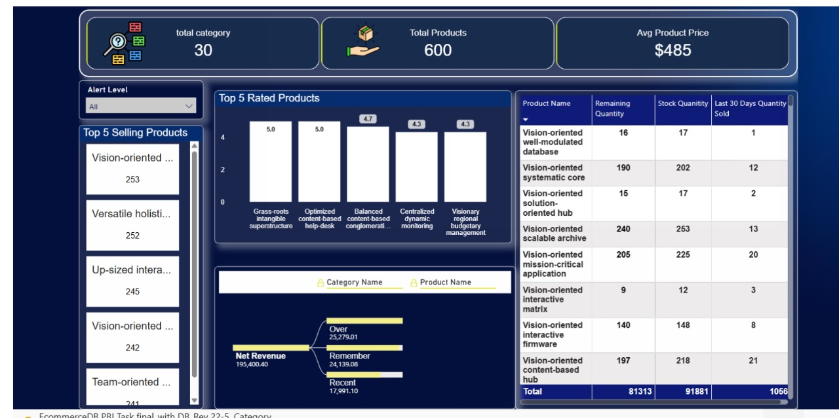
PowerBi (Categories)
Notes:
Here’s a brief you can use to present this slide, focusing on the main business problems and solutions:
Slide Brief: Problems & Solutions for the Business
Key Problems Identified:
Stock Imbalance: Out of 711 products in stock, only 122 are at a high stock level, while the majority (586) are at a medium level. This could indicate potential risks of stockouts for popular items or overstocking for less popular ones.
Limited Product Ratings: Only a few products have high ratings (5.0 and 4.7), and there’s a lack of broader customer feedback, making it difficult to assess overall product satisfaction.
Low Recent Sales for Some Products: The “Last 30 Days Quantity Sold” is very low for most products, suggesting slow-moving inventory or declining demand for certain items.
Concentration of Orders: The top 5 products by orders have similar order volumes (241–253), which may indicate a lack of standout bestsellers or over-reliance on a narrow product range.
Business Strengths:
Diverse Product Portfolio: The business offers 600 products across 30 categories, providing a wide selection for customers.
Healthy Average Product Price: The average product price is $485, which supports strong revenue potential.
Clear Inventory Tracking: The dashboard provides detailed visibility into stock levels and recent sales, enabling proactive inventory management.
Solutions to Address Challenges:
Optimize Inventory Management: Use sales and stock data to adjust purchasing and stocking strategies, focusing on replenishing high-demand items and reducing excess inventory of slow movers.
Encourage Customer Feedback: Implement strategies to collect more product ratings and reviews, helping to identify top performers and areas for improvement.
Boost Sales of Slow-Moving Products: Launch targeted promotions or bundles for products with low recent sales to increase turnover and free up inventory space.
Diversify Bestsellers: Analyze customer preferences and market trends to identify opportunities for new standout products, reducing reliance on a small group of similar items.
Summary: By optimizing inventory, increasing customer feedback, and promoting slow-moving products, the business can improve stock efficiency, enhance customer satisfaction, and drive higher sales across its diverse product range.
Let me know if you’d like this tailored further or need specific talking points for your presentation!

Slide 32


Microsoft Power BI

Slide 33
Microsoft Power BI

Slide 34
Microsoft Power BI

Slide 35
